Slide 1
SEIS 603 Semester Python Project By Robert Krall and Justin Dexheimer

Slide 2
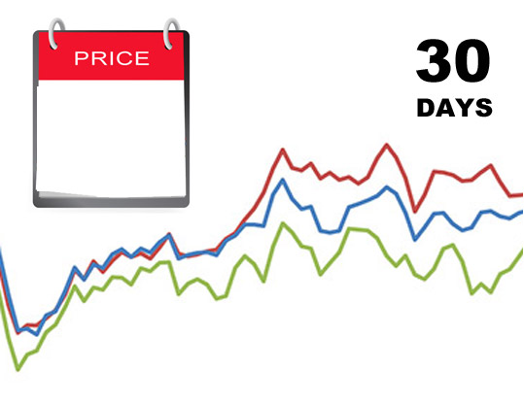
Product Price Tracker App
http://en.prixan.com

Slide 3









Technology used

Slide 4
Gather Data
Web Scrapping
Used Beatifulsoup library
Target, Walmart, Toys R Us, Brooks Running, Amazon
Run Script everyday to dump daily price into database

Slide 5
Application Functionality
Create Account
Add New Items
Track Multi Items Price Over Time

Slide 6
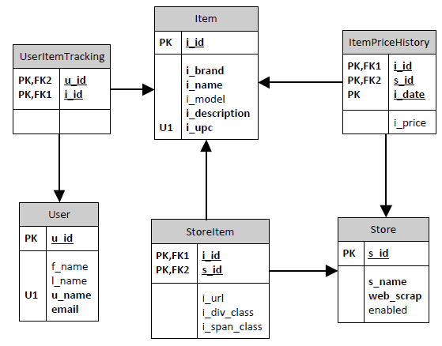
Entity Relationship Diagram

Slide 7
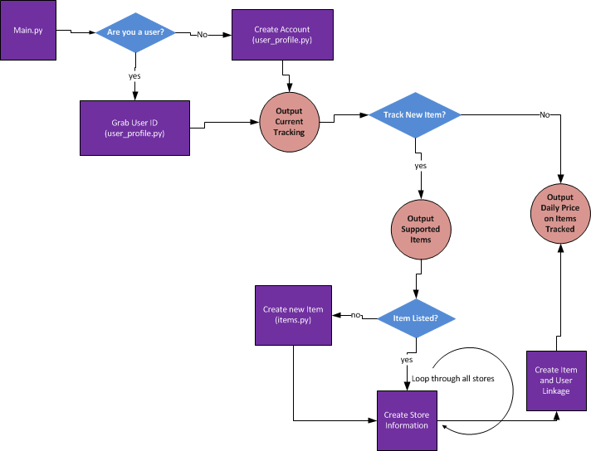
Python App Workflow

Slide 8
Report/Code Sample
Looks View a report in Jupyter and take a look at some python code

Slide 9
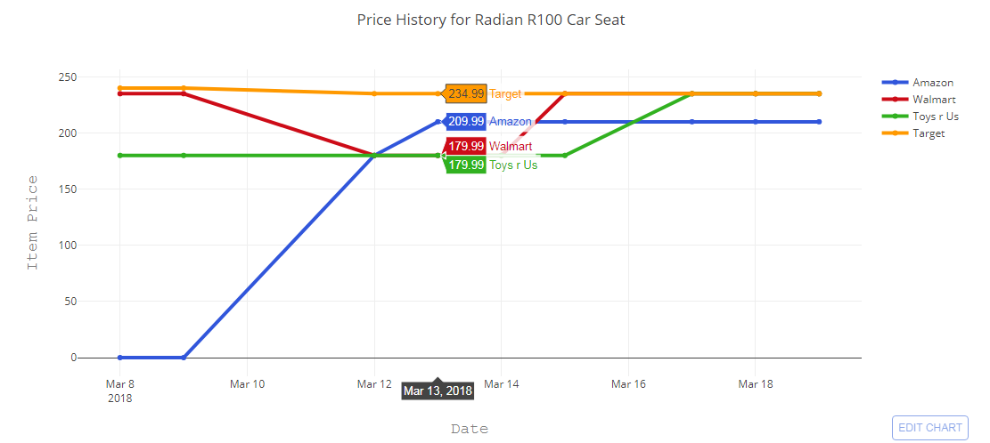
Price History Between Stores

Slide 10
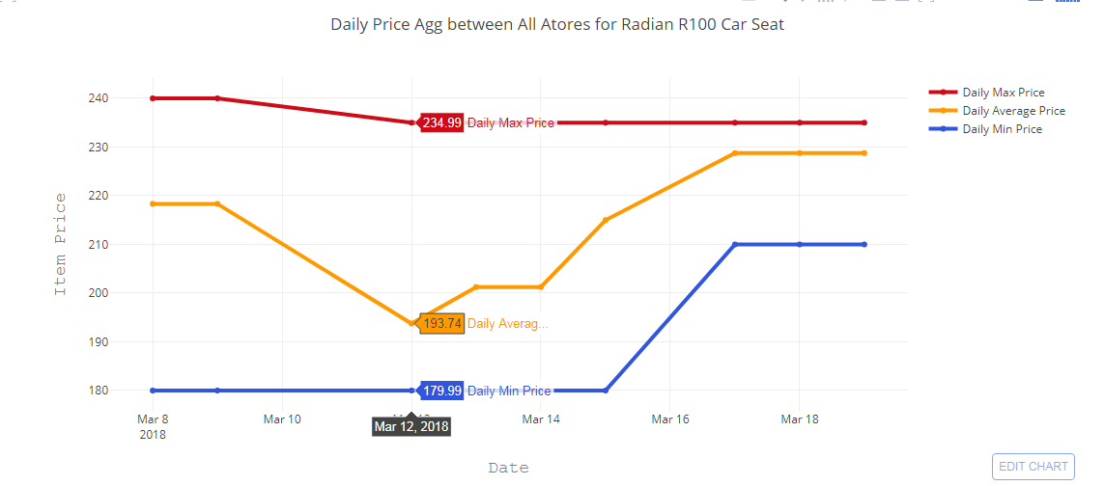
Average Price History

Slide 11
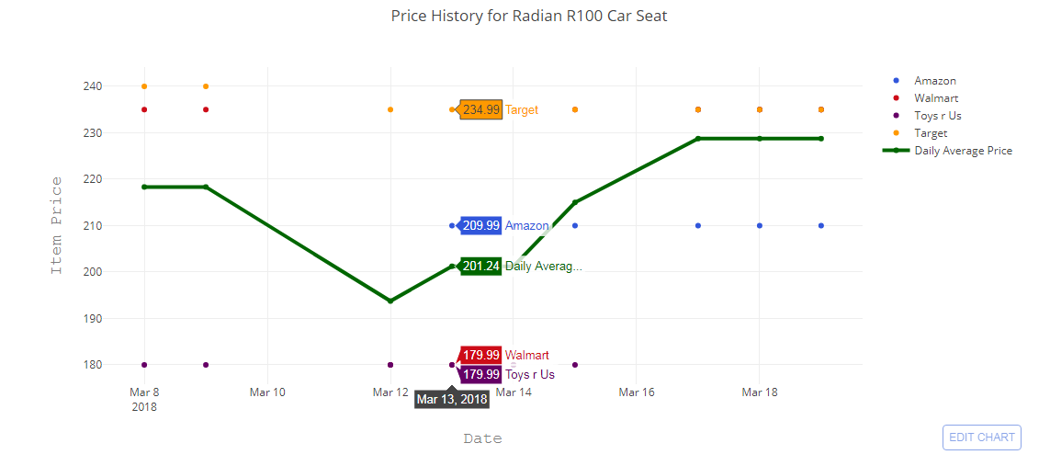
Price History Compared To Average Price

Slide 12

Questions
http://startupmanagement.org

